Slide 1
Study on Application of Bayesian Networks and SEER Database in the Predicting of Non-Small Cell Lung Cancer
By
Wei Chen
Chinedu nwachukwu
Dec. 12, 2017

Slide 2
Overview
Introduction
Bayesian Networks Theory
Construction plan of Tumor Prognostic model
Processing
Conclusion

Slide 3
Introduction
In medicine, accurate diagnosis and prediction is often necessary to model a patients condition over time
The level of uncertainty in clinical medicine is high
The need for prognostic evaluation and diagnostics keep arising to be able to represent and reason with uncertainty
Lung cancer is a leading cause of cancer death worldwide
Non-small cell lung cancer (NSCLC) accounts for approximately 83% of the known cancer cases
For treatment, a combination of chemotherapy and radiotherapy is mainly used in contrast to surgical resection
However, the patients with locally advanced NSCLC that use radiotherapy suffer from a high local failure rate

Slide 4
Introduction (cont’d)
In spite efforts to improve this, a low 2-year local control rate of 27% require innovative diagnostics and the need of a prognostic model to improve early detection of tumor local failure
The Surveillance, Epidemiology and End Results (SEER) database was set up by NCI – National Cancer Institute in 1973 to track all the cancer patients
The database is one of the worlds recognized data sources for cancer patients. Reliable data provision in support for clinical research
Some scholars set up a rhabdomyosarcoma and other disease survival model by simple statistics method from the SEER database

Slide 5
Bayesian networks theory
Bayesian Networks (BN) is a probabilistic graphical model that represents a set of random variables and their conditional dependencies via a directed acyclic grapg (DAG)
Bayesian Network (BN) models are a class of machine learning models with some unique characteristics that make them suitable for medical applications
BN has been used as a tool to create individual predictive models due to its several attractive characteristics, which have led to various successes in the field of oncology (Tumors)
They are currently the most powerful and popular method for representing and reasoning with probabilistic uncertainties inherent to the medical domain
The representation of BN is in the form of a graph which is relatively easy to interpret for the medical community
The dependence relations between the features revealing the cause-effect relationships are considered in the medical data

Slide 6
Bayesian network (BN) Applications
Jayasurya et al (2010) proposed a BN model for survival prediction in lung cancer patients
Velikova et al (2009) designed a multi-view mammorgraphic analysis system using a BN framework to detect breast cancer, which showed potential in selecting the most suspicious cases
Chen et al (2006) proposed an effective BN structure based on mutual information and k2 algorithm to reconstruct reliable gene netwoks
Van-Gerven et al (2008) demonstrated the development of a prognostic model for carcinoid patients using dynamic BN
Smith et al (2009) developed a prognostic model for prostate cancer with intensity modulated radiation therapy (IMRT) plans and was able to calculate the quality-adjusted for life expectancy for each plan

Slide 7
The study?
The present study, will use SEER database to extract the NSCLC cases of Asians
Adopt the relationships and applicability of better machine learning methods that will build Asian NSCLC prognosis model
Prediction assessment system
Provide decision support for the treatment and prognosis of clinicians
Notes:
Prognosis: The likely cause of a disease or ailment
Clinician:

Slide 8
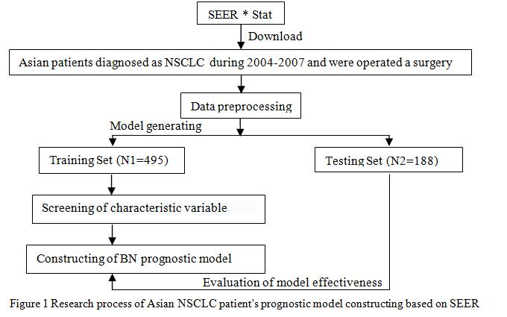
CONSTRUCTION PLAN OF TUMOR PROGNOSTIC MODEL

Slide 9
Process – data download
The data of “Incidence – SEER18 Regs Research Data+Hurricane Katrina Impacted Louisiana Cases, Nov 2014” was invoked by the SEER statistical software
The version of the SEER statistical software was released at the end of 2012
The data downloaded is based on the morphological coding of ICD-O-3 malignant tumor

Slide 10
Process – basis for variable selection
According to the American Joint Committee on Cancer (AJCC), the National Comprehensive Cancer Network (NCCN) and Collaborative Stage Manual online help (CS), the related fields to the patients prognostic factors, all the fields that contained the following variables where extracted from SEER statistical software
  Stage: - Grade, Size
  Positive: - Exam, Ratio
  Status: - Age, Ratio
The data was registered from the first diagnosis and the information was organized to lead in tables

Slide 11
Process – screening of variable
In determining the variable independence of the patients survival, SPSS22.0 software was first applied to analyse the training samples with one-way ANOVA analysis test
ANOVA (Analysis of Variance) is a statistical method used to test differences between two or more means
Logistic regression analysis was used to analyse the variables obtained by single factor analysis
Screening NSCLC high correlation prognostic factors, P<0.05 was statistically significant
The adjustment variables are incorporated into the final model in combination with the recommendations of clinicians
Notes:
It may seem odd that the technique is called analysis of variance rather than analysis of means
As you will see, the name is appropriate because inferences about means are made by analyzing variance

Slide 12
Process – construction of tumor prognostic model
Supervised learning method in machine learning was selected to the tumor prognosis prediction model
R Studio software was applied to establish Bayesian survival prediction model and to complete the structure adjustment of Bayesian Networks
This was used to construct an effective prognostic model
R Studio is a free open source integrated development environment for R that is used for statistical computing and graphics
Notes:
RStudio is a free and open-source integrated development environment for R, a programming language for statistical computing and graphics. RStudio was founded by JJ Allaire, creator of the programming language ColdFusion.

Slide 13
Process – evaluation of model effectivelness
The data mining software WEKA was selected to compare the predicting accuracy
The accuracy and area under the curve of ROC among the models of BN was compared for other common classified

Slide 14
Processing – construction of tumor...
There are three stages to the processing of these data for the prognostic model
  Construction of tumor prognostic model
    Research object:
      Asian patients diagnosed with NSCLC since 2014 were selected as the final study subjects
      Patients deaths within 5 years and patients who have been followed up and still survived within the 5 years was 683
    Research Variables:
      17 prognostic variables were extracted from SEER as seen in the next slide.
      The last 4 are continuous variables and the others are categorical variables
    Outcome Variable:
      The five-year survival of NSCLC patients is an important index to evaluate the prognostic effect, and was treated as the dependent variable.
      A month is made as a survival period unit and the conversion of classification variables. Patients who lived for 60 months or more were considered living otherwise considered dead

Slide 15
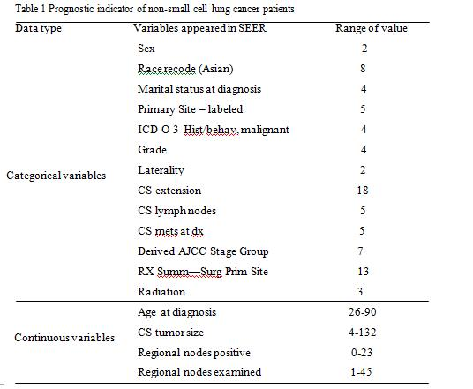

Slide 16
Processing – construction of tumor...
Feature variable selection:
  To strimeline the prognostic variables and improve the prediction accuracy of the model, it is required to carry out a high correlation prognostic factors
  After the one-way ANOVA analysis, the prognostic variables were (P<0.05):
    age at the time of diagnosis,
    CS tumor size,
    histological grade,
    tumor staging,
    CS extension ,
    CS lymph nodes,
    regional nodes positive,
    marital status,
    race recode,
    CS mets at dx,
    operation type,
    and whether radiotherapy.

Slide 17
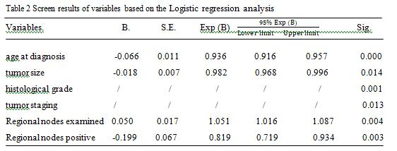

Slide 18
Data preprocessing:
  Interval method was selected for metric data to discretize the serious deleted data, false record, and patient's information of deaths from non-lung cancer.
  The discretization method aimed to divide the interval [X₀, X_{N- 1}] into the same subinterval of size D and the suggestion of discretization was given according to the sub-interval index,
  The observation index i and the discrete level j satisfy the following conditions

Slide 19

The above data preprocessing step is realized by calling BN learn's function package in software R Studio.
Then the data is divided into training set (N1=495) and test set (N2=188) according to the proportion of about 70% and 30%.
The training set is used for network learning and adjustment, thus constructing the prognostic model and measuring.
The test set is used to evaluate the performance of the model.

Slide 20
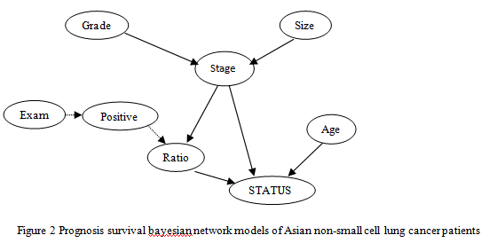
Const & prediction of the prognostic model

Slide 21
Processing – comparison experiment
The decision tree, support vector machine and artificial neural network method are used to establish the prognostic model, and compared the prediction results with prognostic model, which is set up at this study.
In WEKA, the corresponding method of J48, SMO and Multilayer Perceptron are selected to establish the prognostic model and the parameter acquiescence.
The prediction accuracy and model performance evaluation of 4 machine learning algorithms are shown in table 3 and table 4.

Slide 22
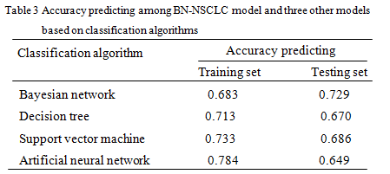

Slide 23
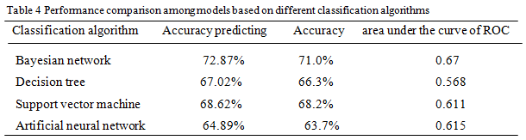

Slide 24
Processing – experimental analysis
The study found that the NSCLC prognosis model constructed by Bayesian network was optimal
Table 3 showed that although the decision tree, support vector machine (SVM), and artificial neural network in the predictive accuracy of the training set was higher than that of Bayesian network,
The testing set three prediction accuracy, were significantly reduced in the value compared to the training set, failed to adapt to the new data very well.
It is indicated that they were not suitable for practical application, the model of Bayesian networks is better than the other three models in fitting degree.
Table 4 showed that the data in predicting accuracy and area under the ROC curve of the BN model is significantly higher than that of the other three machine learning algorithms

Slide 25
conclusion
In this study, the survival prognosis model of patients with non-small cell lung cancer patients were established, and the prediction accuracy was 72.87%.
By constructing a Bayesian network to explore the relationship between the prognostic variables and the impact on the survival situation, and on the basis of the internal network structure adjustment combined with clinical expert advice, the relationship between nodes in the model were better explained.
Applying the SEER database in Asia cancer as the main research object to build its prediction model, and playing a supplementary role on the judgment of the prognosis of patients with postoperative five years.

Slide 26
Thank you
Questions?

